Slide 1
REAL ESTATE CATALOG
Invest in Dubai real estate for unparalleled growth and luxury

Slide 3
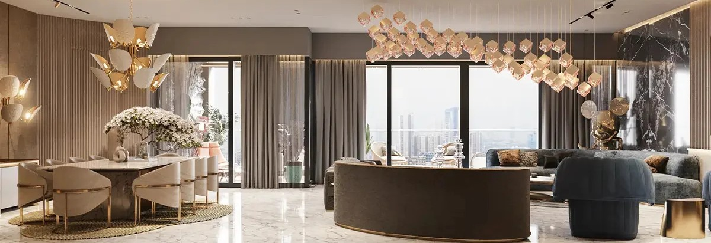
Our Services
Property Sales and Purchases
Residential Sales: Assisting clients in buying and selling residential properties including apartments, villas, and townhouses. Commercial Sales: Facilitating the purchase and sale of commercial properties such as office spaces, retail outlets, and warehouses. Off-Plan Sales: Marketing and selling properties that are under construction or in the planning phase

Slide 4
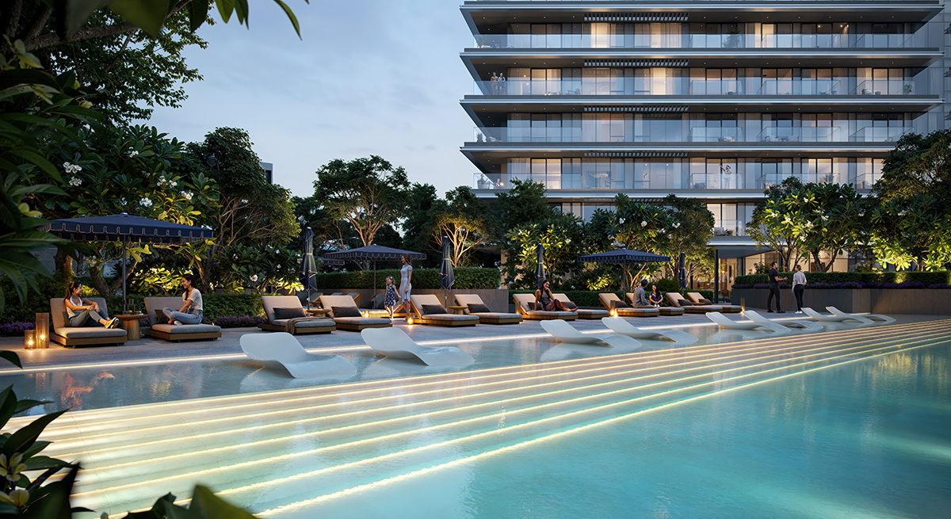

Slide 5
Creek Harbour
AED 1,81 M
2029
About the Project
Altan offers luxury living with stunning creek, city, and golf course views. Enjoy an active, nature-connected lifestyle with parks, sports facilities, retail, and relaxing waterfront spaces in a vibrant community.
PAYMENT PLAN
70%
during construction
20%
On Handover
10%
On booking

Slide 6
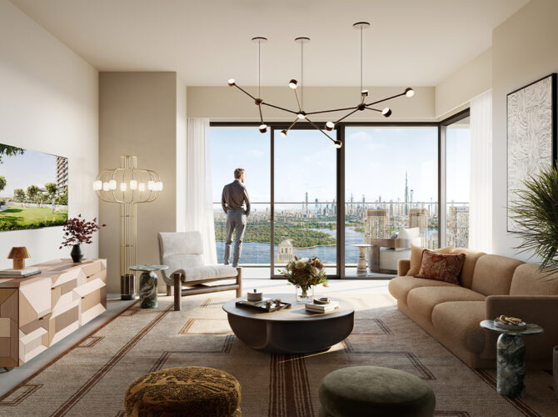
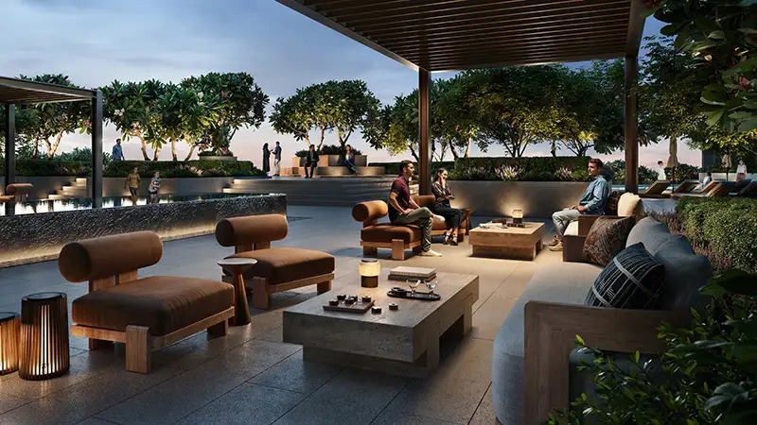
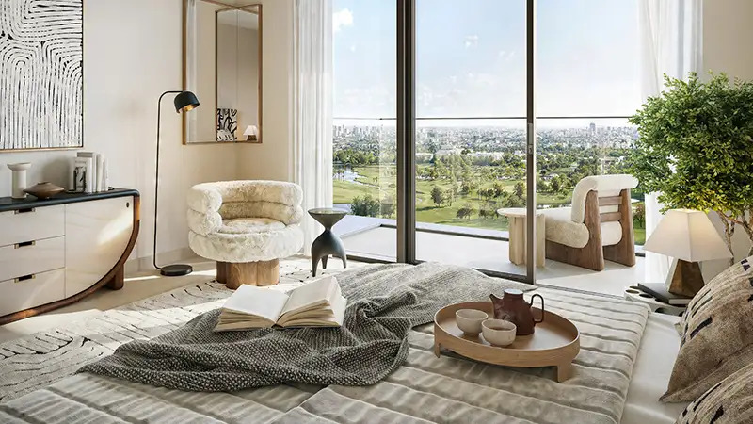
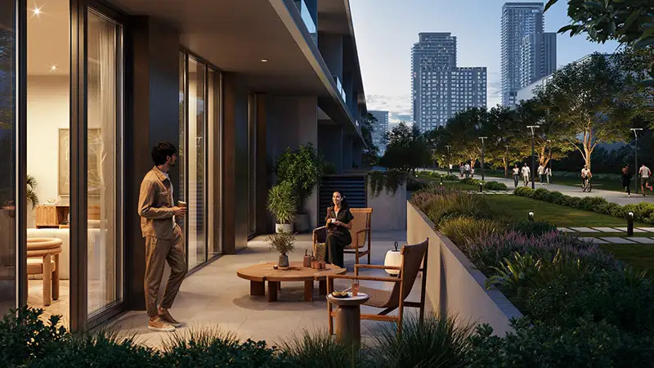
GALLERY

Slide 7
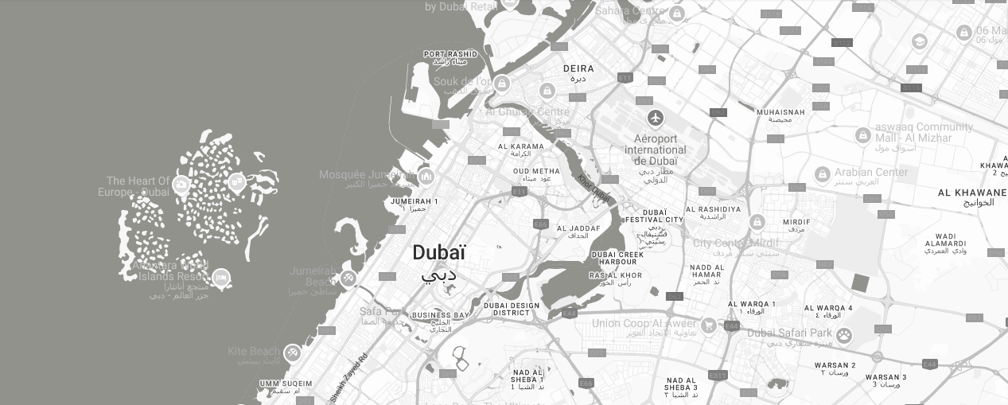
10 Minutes
Dubai Mall
10Minutes
Downtown Dubai
12 Minutes
Burj Khalifa
15 Minutes
DXB Airport

Slide 8
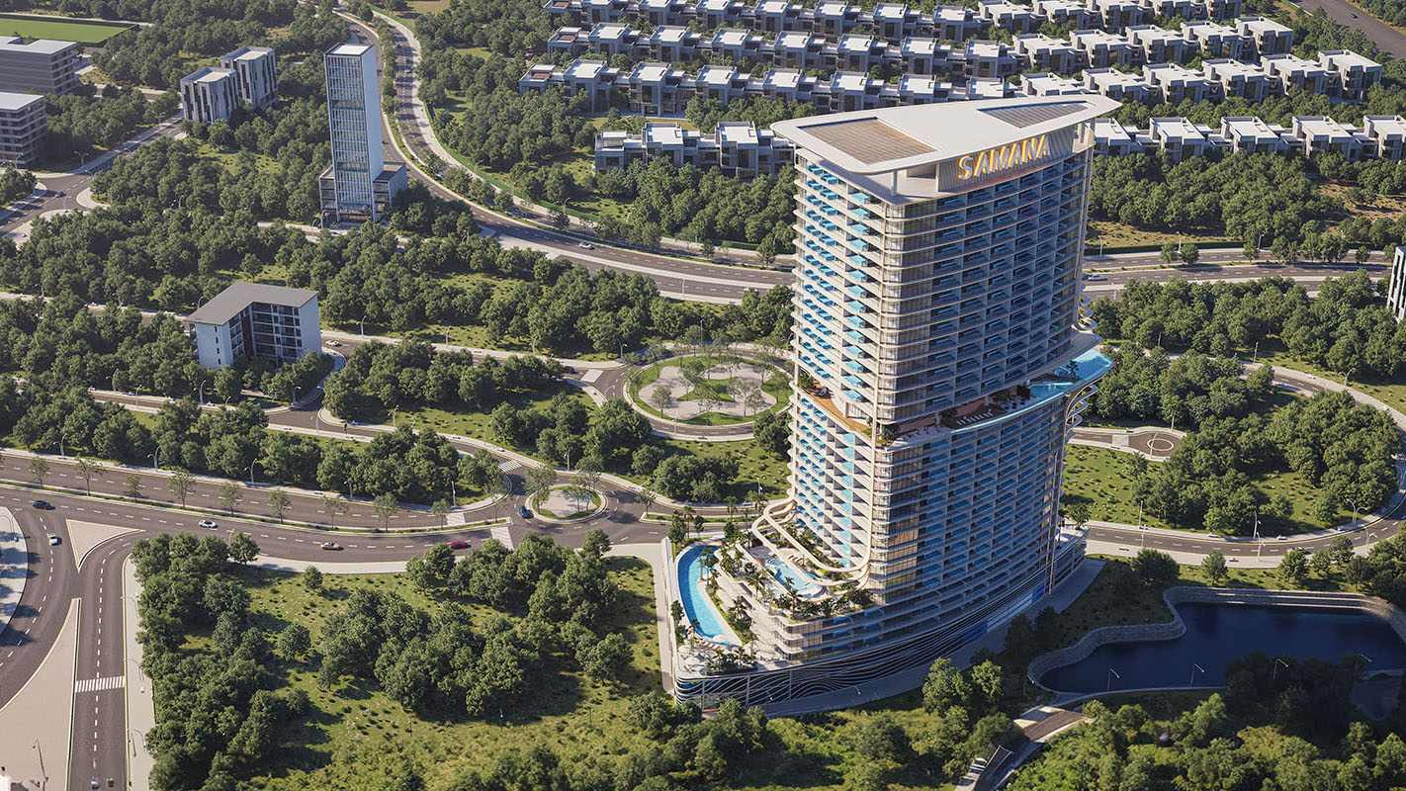

Slide 9
Majan
AED 759K
2028
About the Project
SAMANA Barari Heights offers an elevated lifestyle surrounded by elegance, nature, and panoramic views. With spacious homes from 1 to 4 BHK, including duplex options, it blends luxury with wellness-focused amenities like an aquatic gym, yoga zone, trampoline park, spa, and rooftop experiences—creating a serene and inspiring living environment.
PAYMENT PLAN
15%
Down Payment
1%
Only Monthly

Slide 10
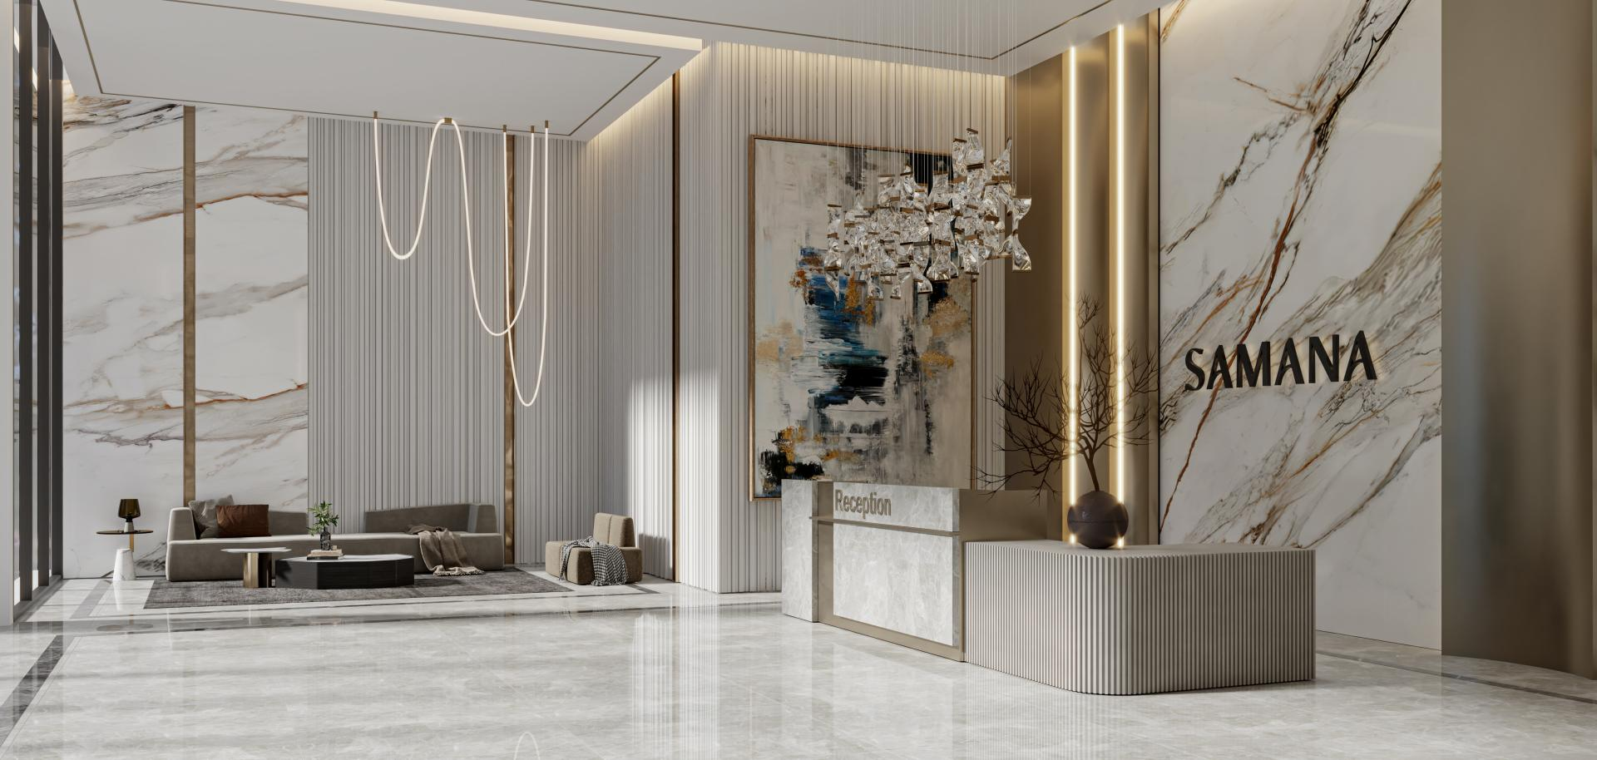
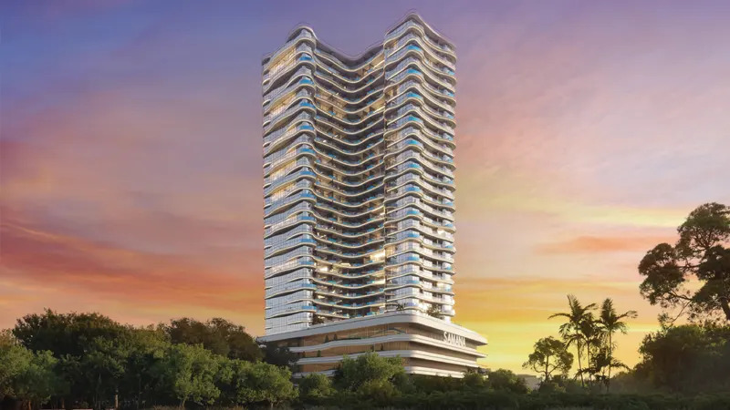
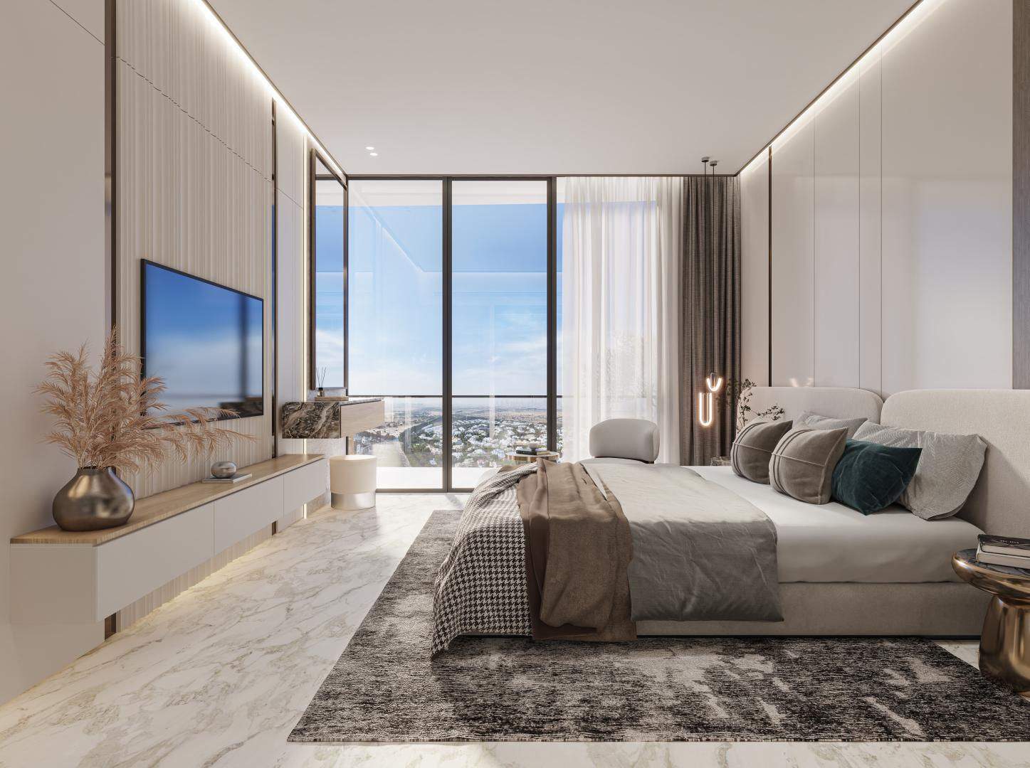
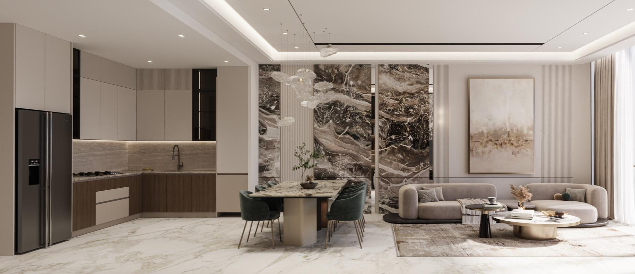
GALLERY

Slide 11
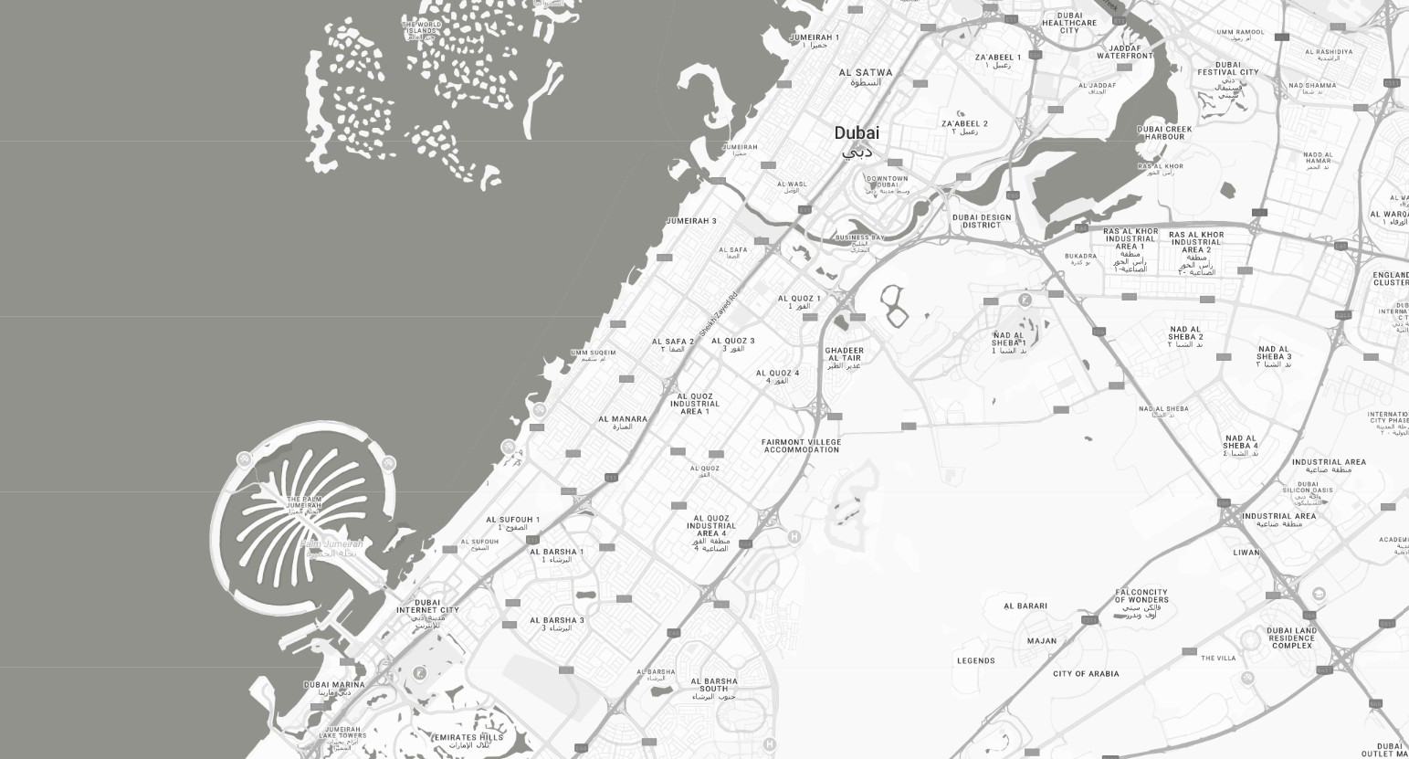
10 Minutes
Global Village
15 Minutes
IMG Worlds of Adventure
20 Minutes
Dubai Downtown
25 Minutes
DXB Airport

Slide 12
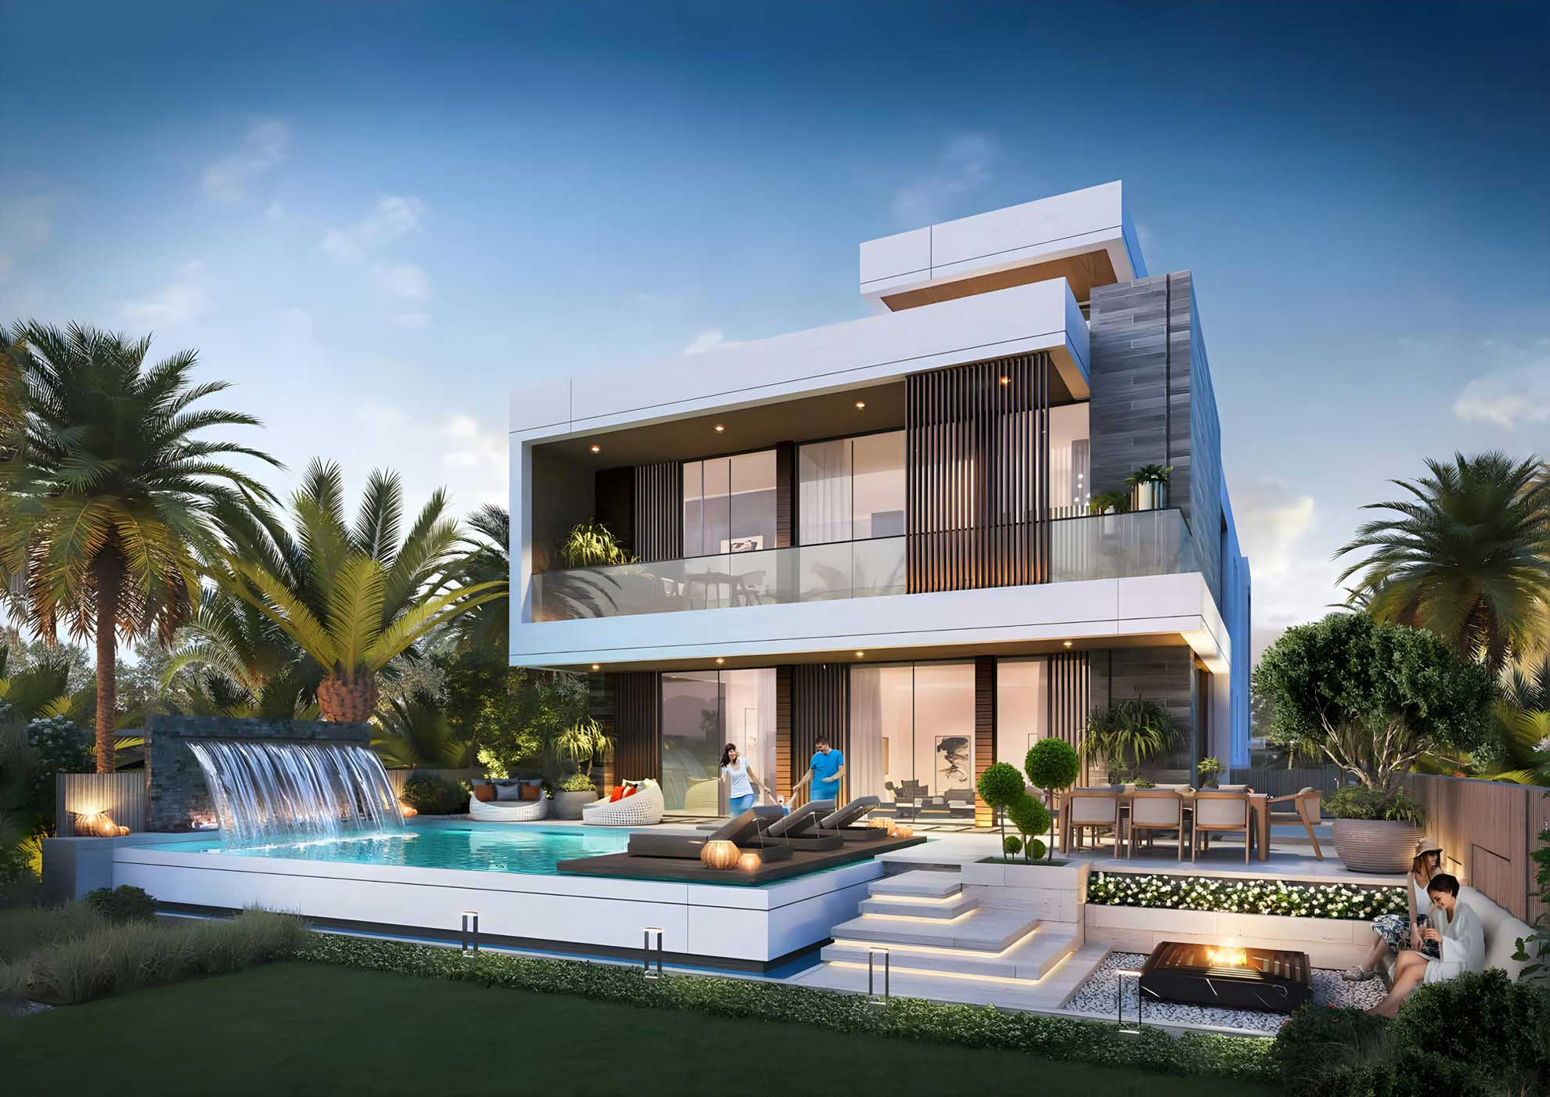

Slide 13
Dubailand
AED 2.25M
2028
About the Project
Damac Islands is a prestigious master community development offering luxury villas and townhouses in Dubai Land, near Meraas Cherrywoods. Designed for upscale waterfront living, this development features 4 & 5-bedroom townhouses, with built-up areas ranging from 2,208 to 3,178 sq.ft. and plot sizes between 1,770 and 3,178 sq.ft..
PAYMENT PLAN
20%
On Booking
50%
during construction
30%
On Handover

Slide 14
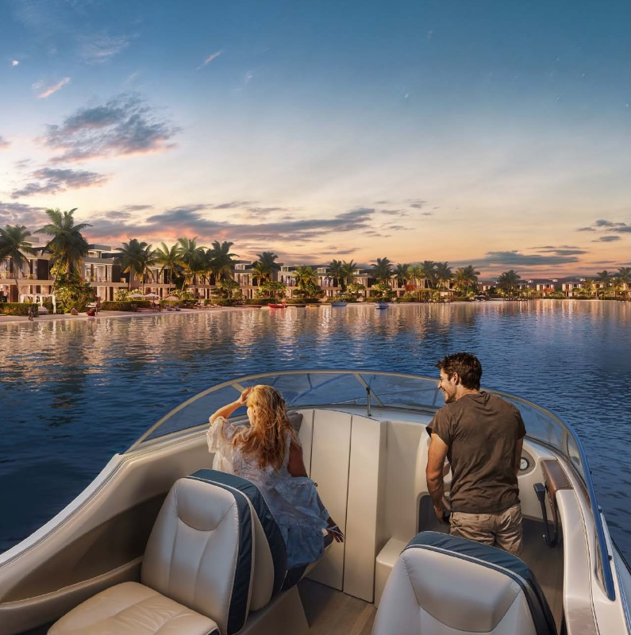
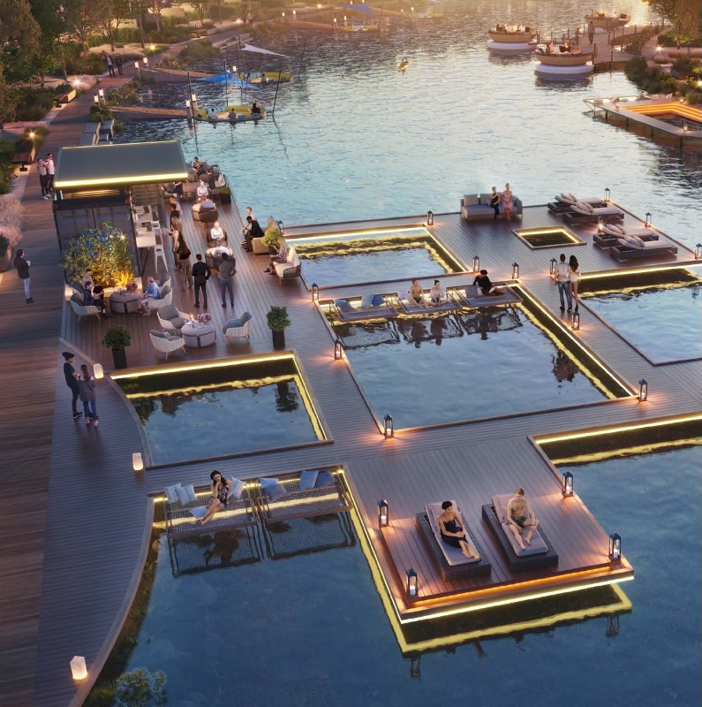
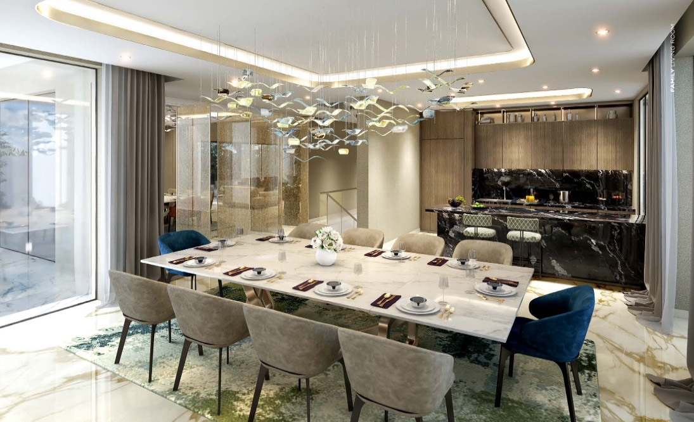
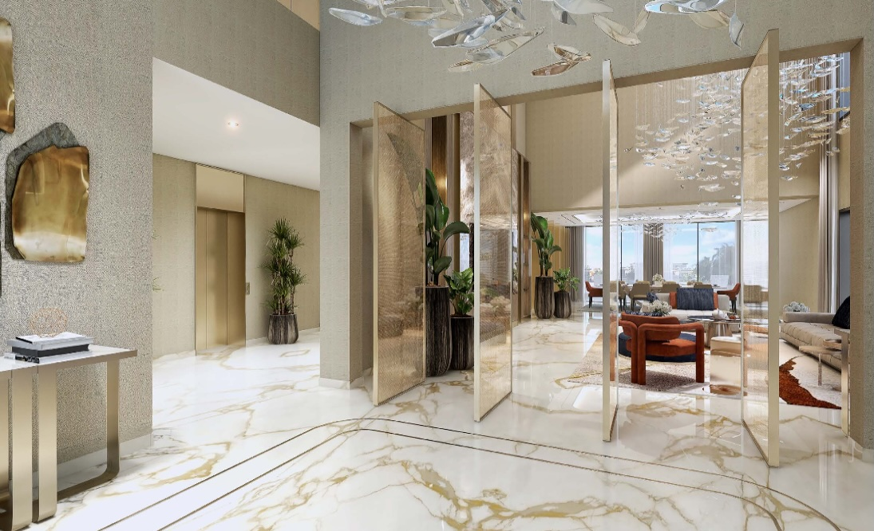
GALLERY

Slide 15
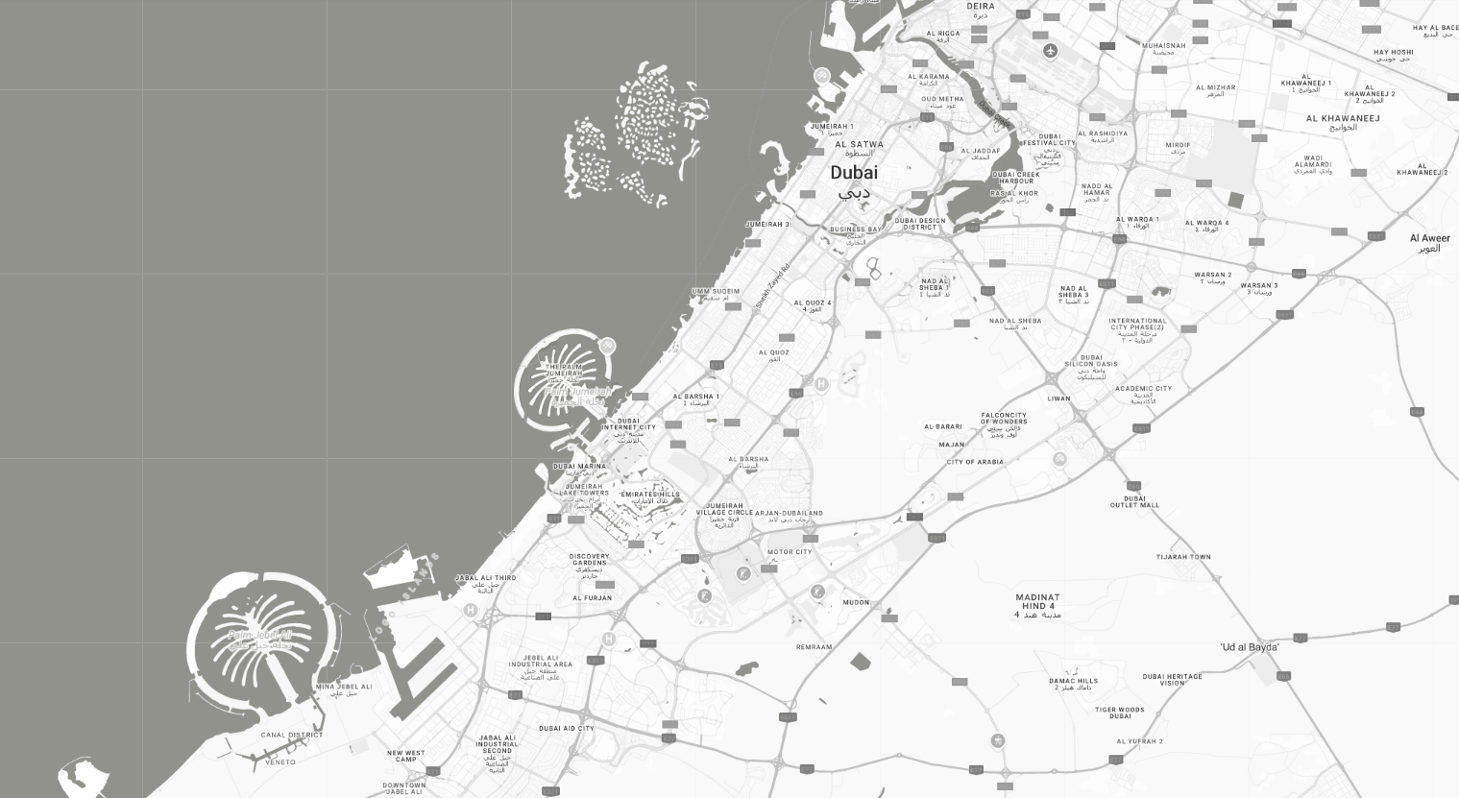
20 Minutes
Downtown Dubai
20 Minutes
DXB Airport
30 Minutes
Dubai Marina
50 Minutes
DWC Airport

Slide 16
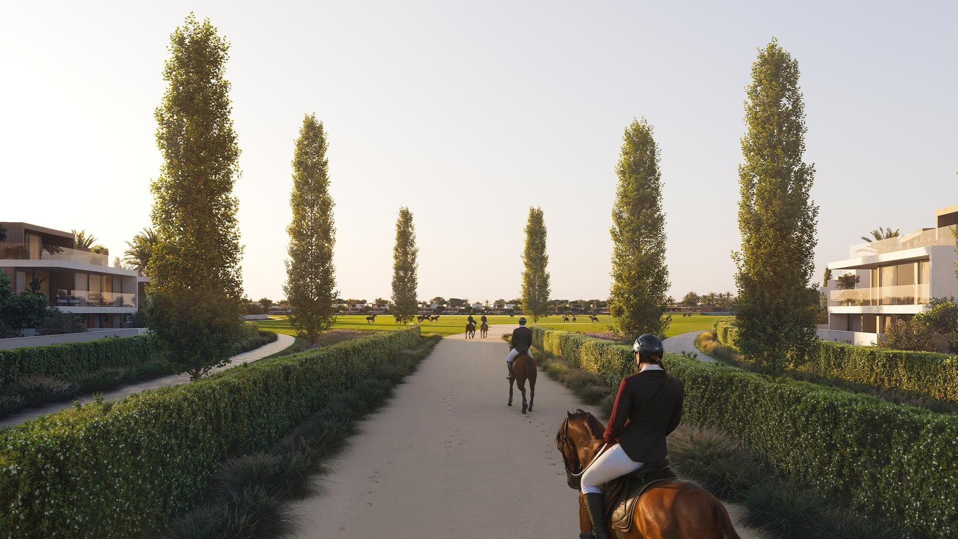

Slide 17
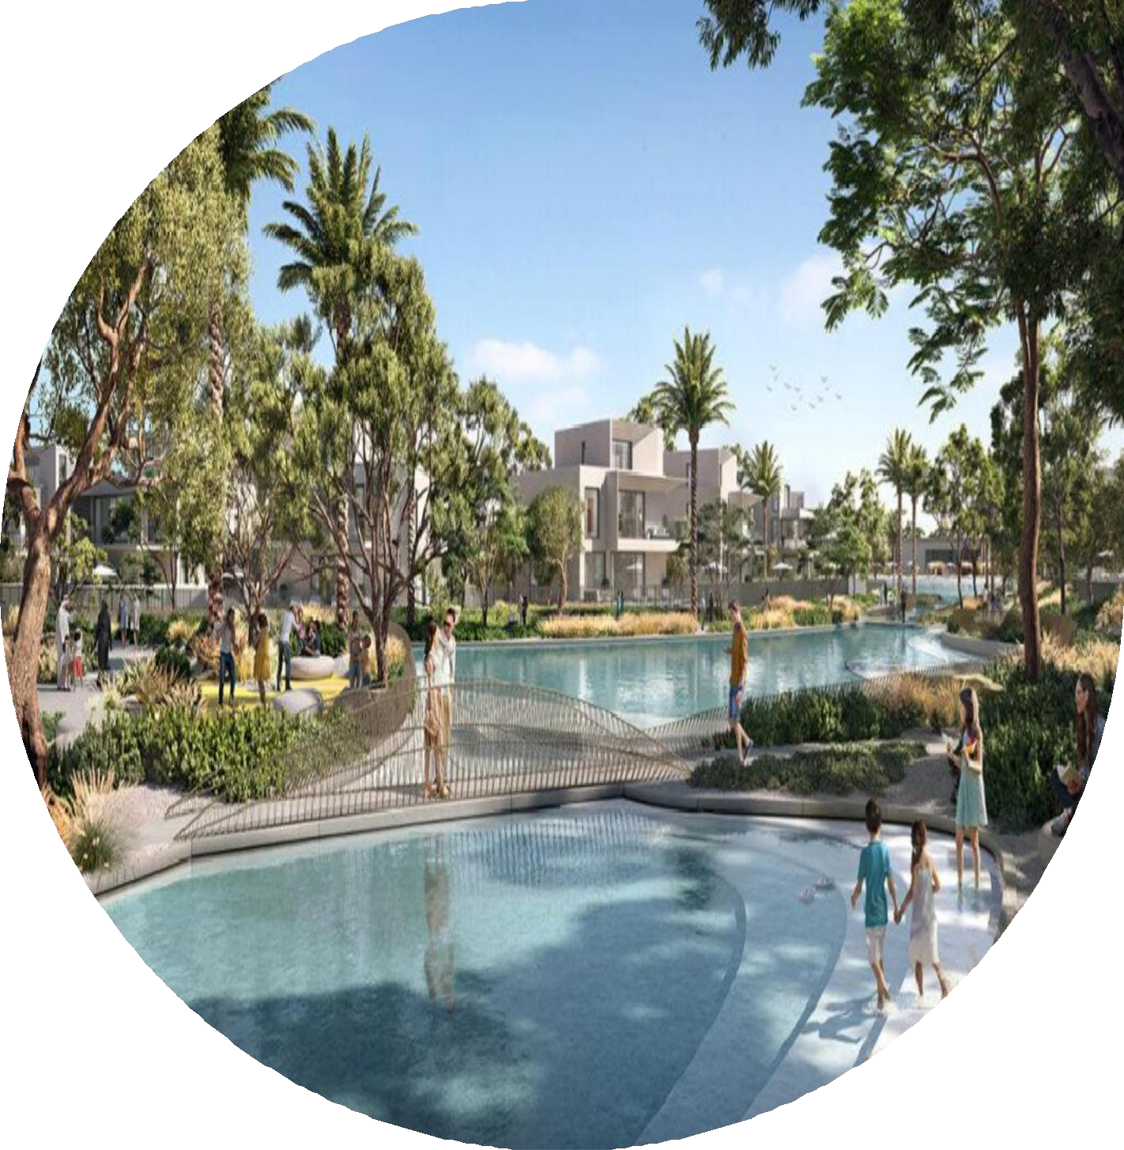
Grand Polo Club Resort
About the Project
AED 5,67 M
2029
Club Polo Resort by Emaar is a refined equestrian community featuring luxurious 3, 4 & 5-bedroom villas. Set amid vast green spaces and world-class polo fields, it blends heritage charm with modern elegance. With a signature clubhouse, scenic trails, and wellness-focused amenities, it offers a serene yet sophisticated lifestyle in the heart of Dubai’s countryside.
PAYMENT PLAN
80%
during construction
20%
On Handover

Slide 18
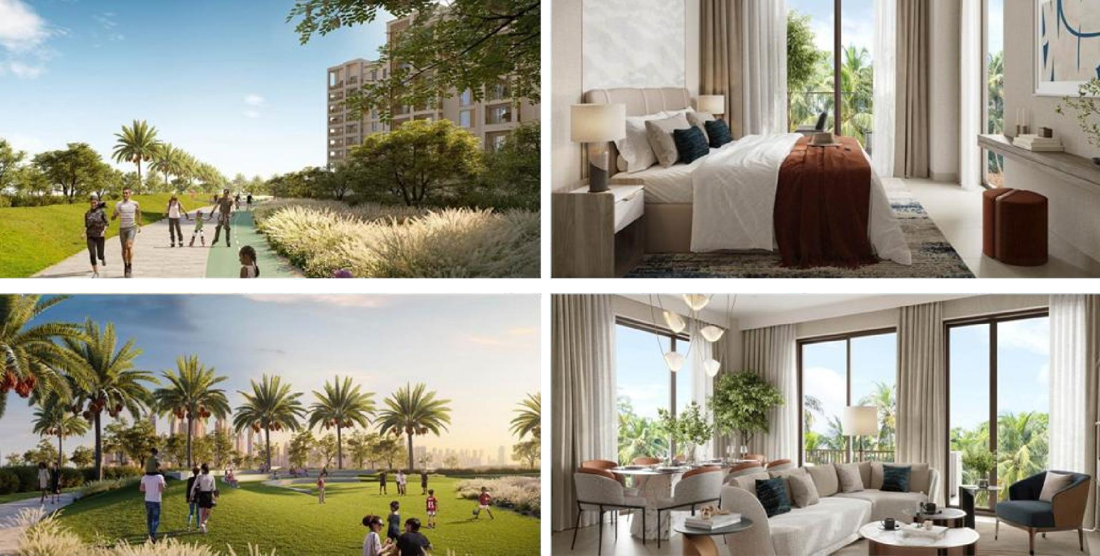
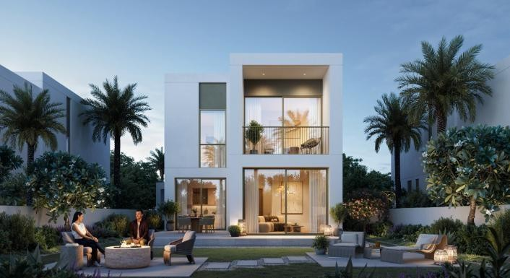
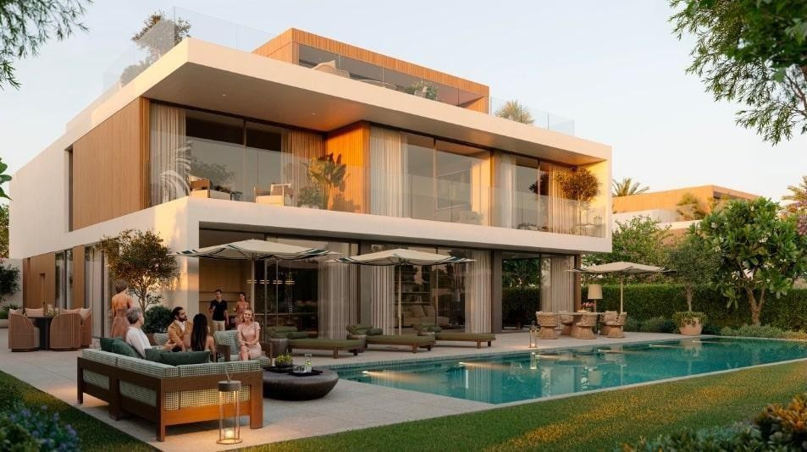
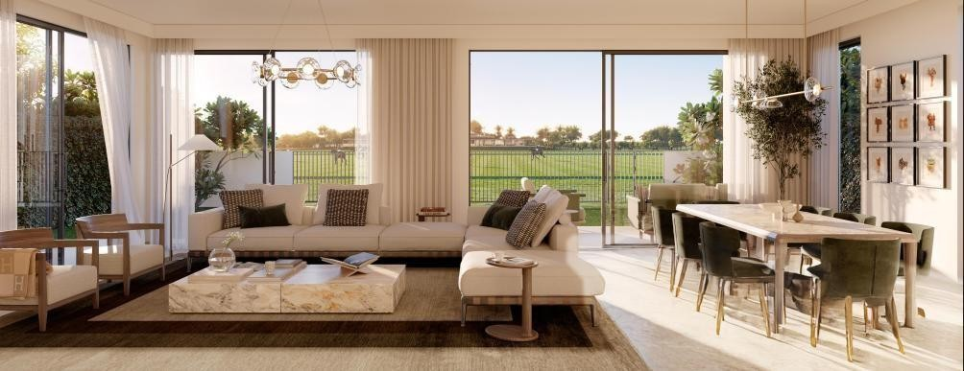
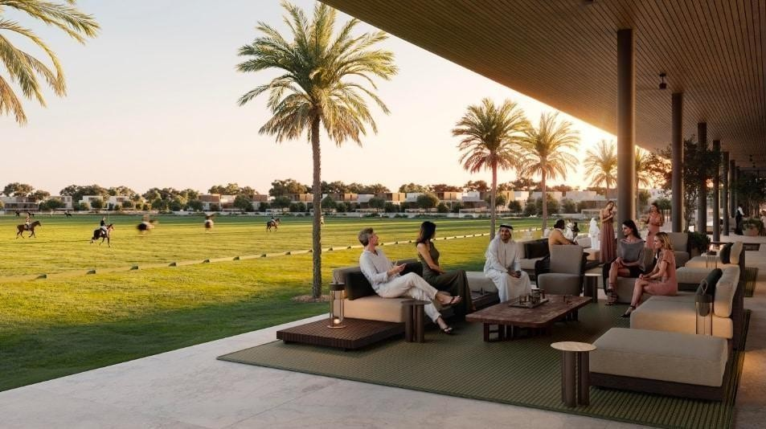
GALLERY

Slide 19
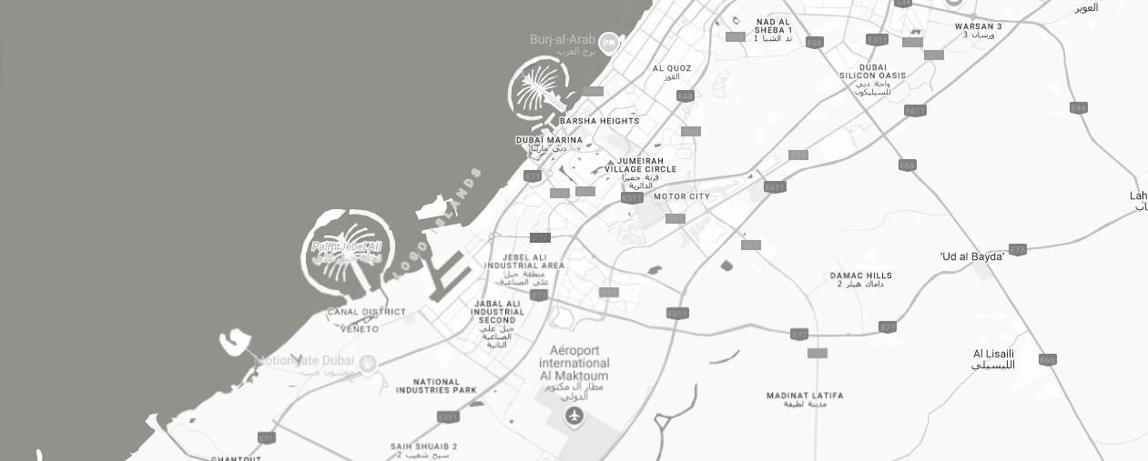
10 Minutes
Al Maktoum International Airport
20 Minutes
Dubai Hills Estate
28 Minutes
Dubai Marina
35 Minutes
Downtown Dubai

Slide 20
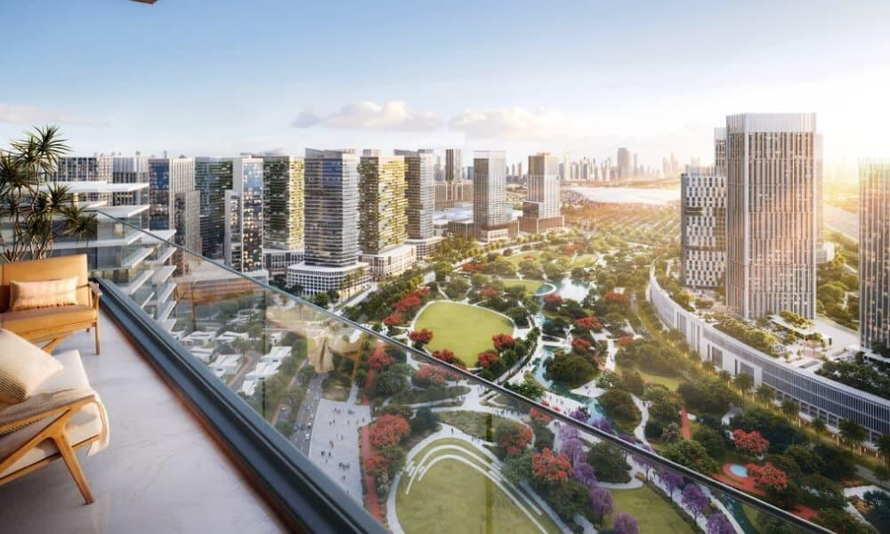

Slide 21
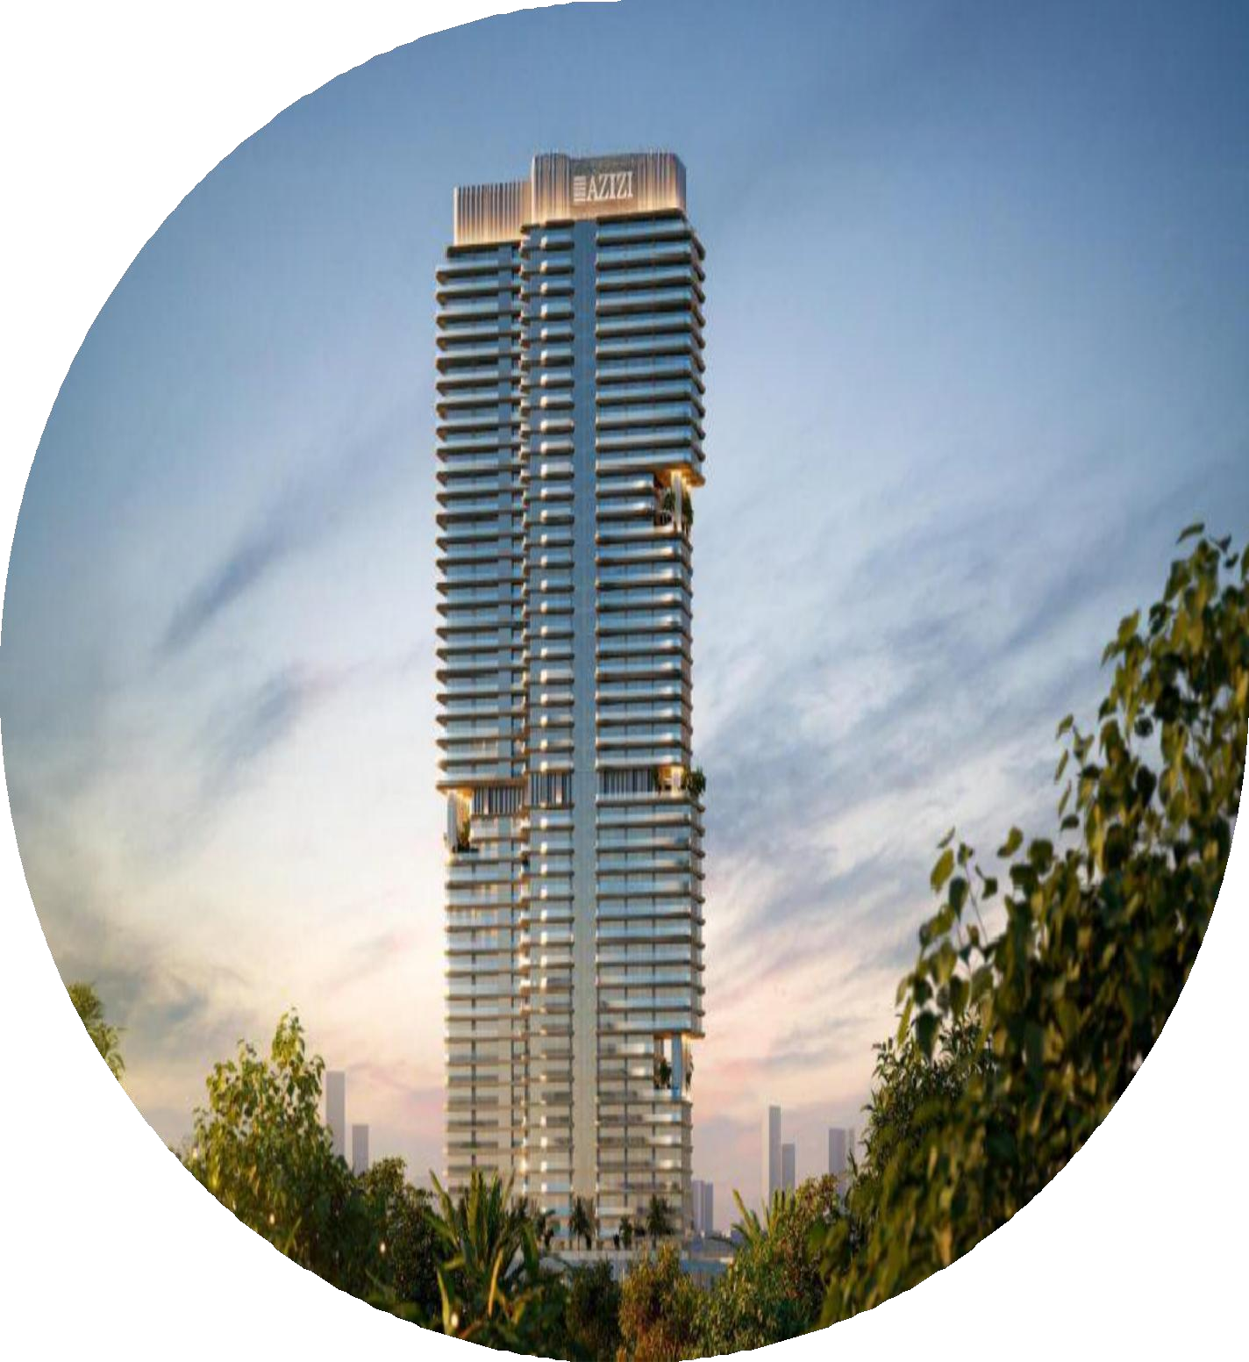
AED 550K
Dubailand 2028
About the Project
Azizi Milan is a luxury residential project in Dubailand, inspired by Milan’s sophisticated style and Dubai’s vibrant energy. The development features studio to 3-bedroom apartments with bespoke interiors and panoramic views. Residents enjoy premium amenities such as wellness districts, fashion-inspired retail, and easy access to major Dubai landmarks.
PAYMENT PLAN
10%
Down payment
50%
during construction
40%
On handover

Slide 22
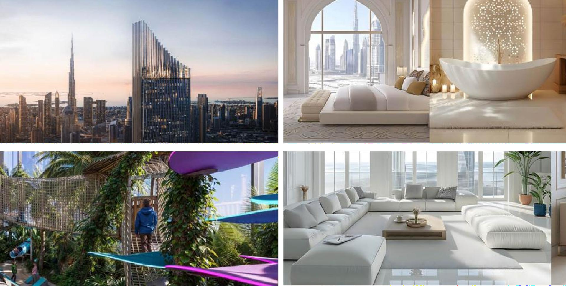
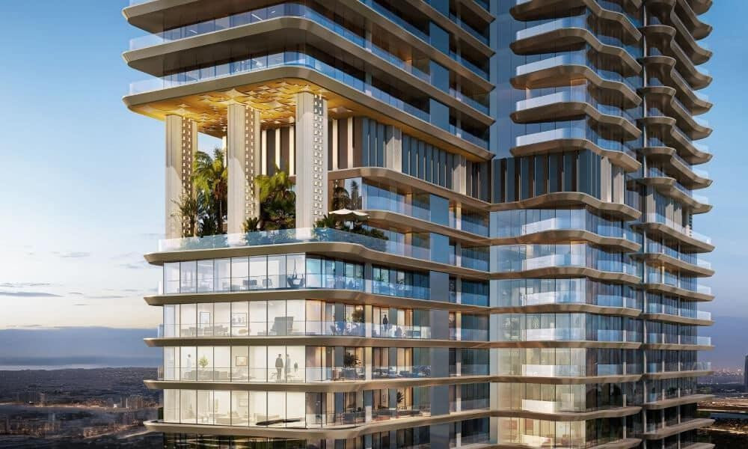
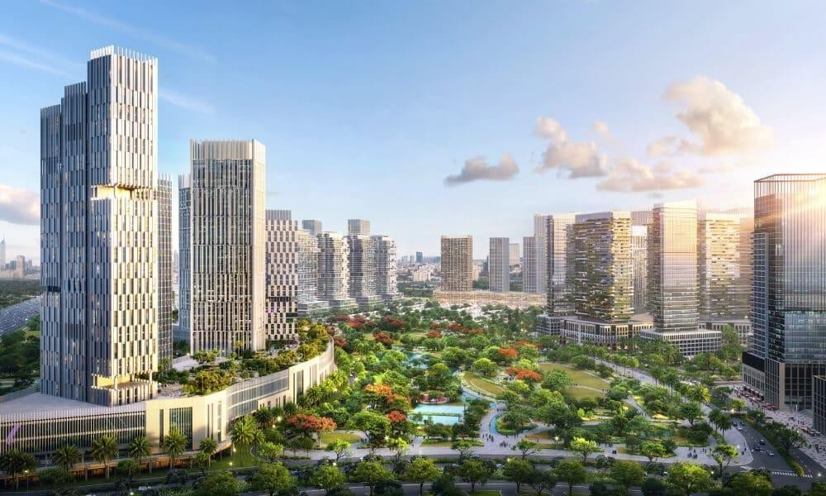
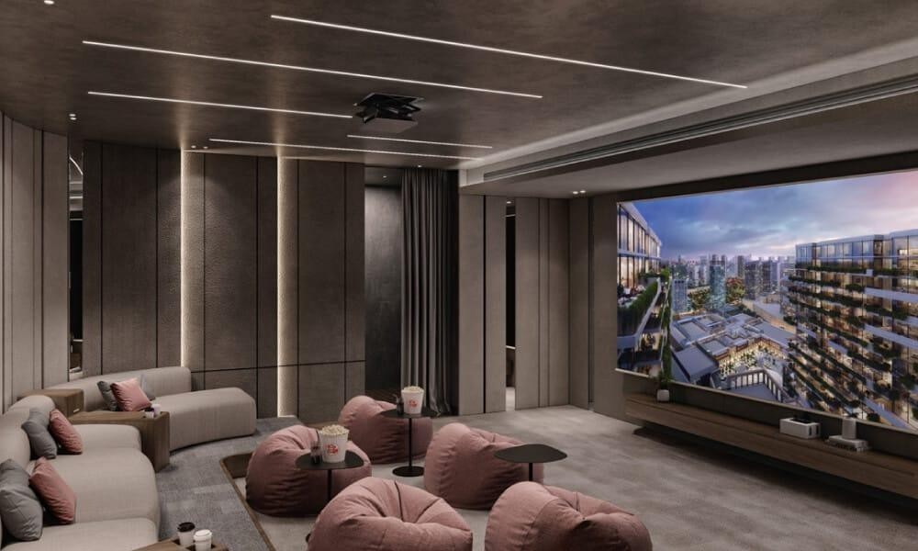
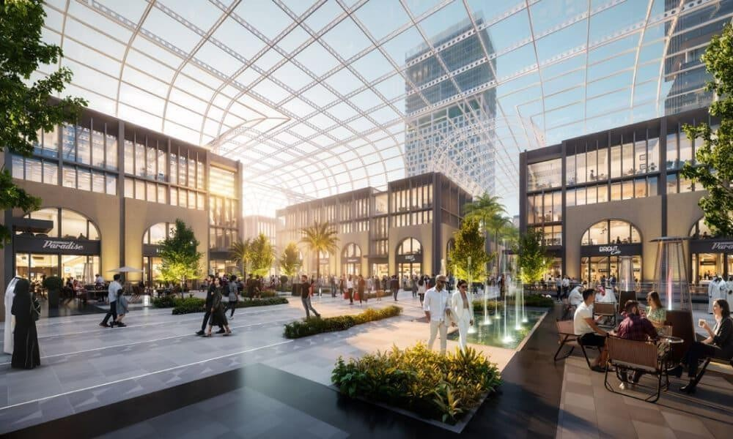
GALLERY

Slide 23
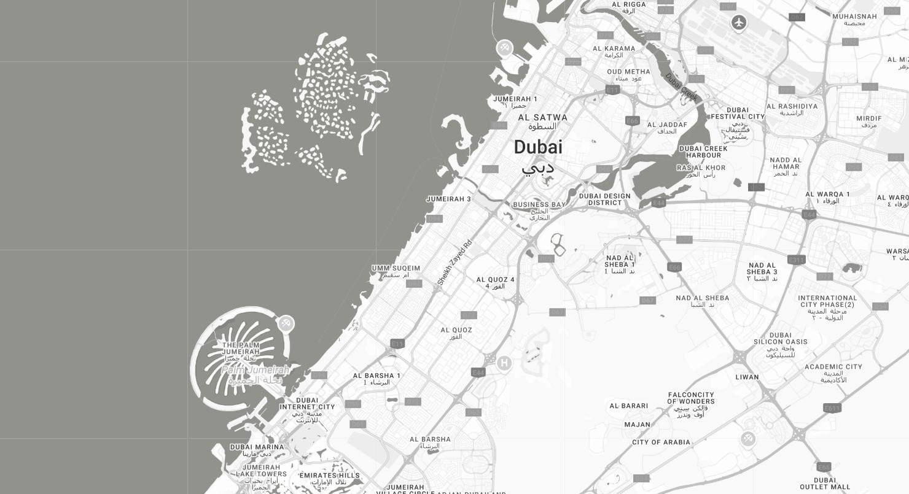
01 Minutes
IMG Worlds
05 Minutes
Global Village
12 Minutes
Dubai Miracle Garden
25 Minutes
Dubai International Airport:

Slide 24
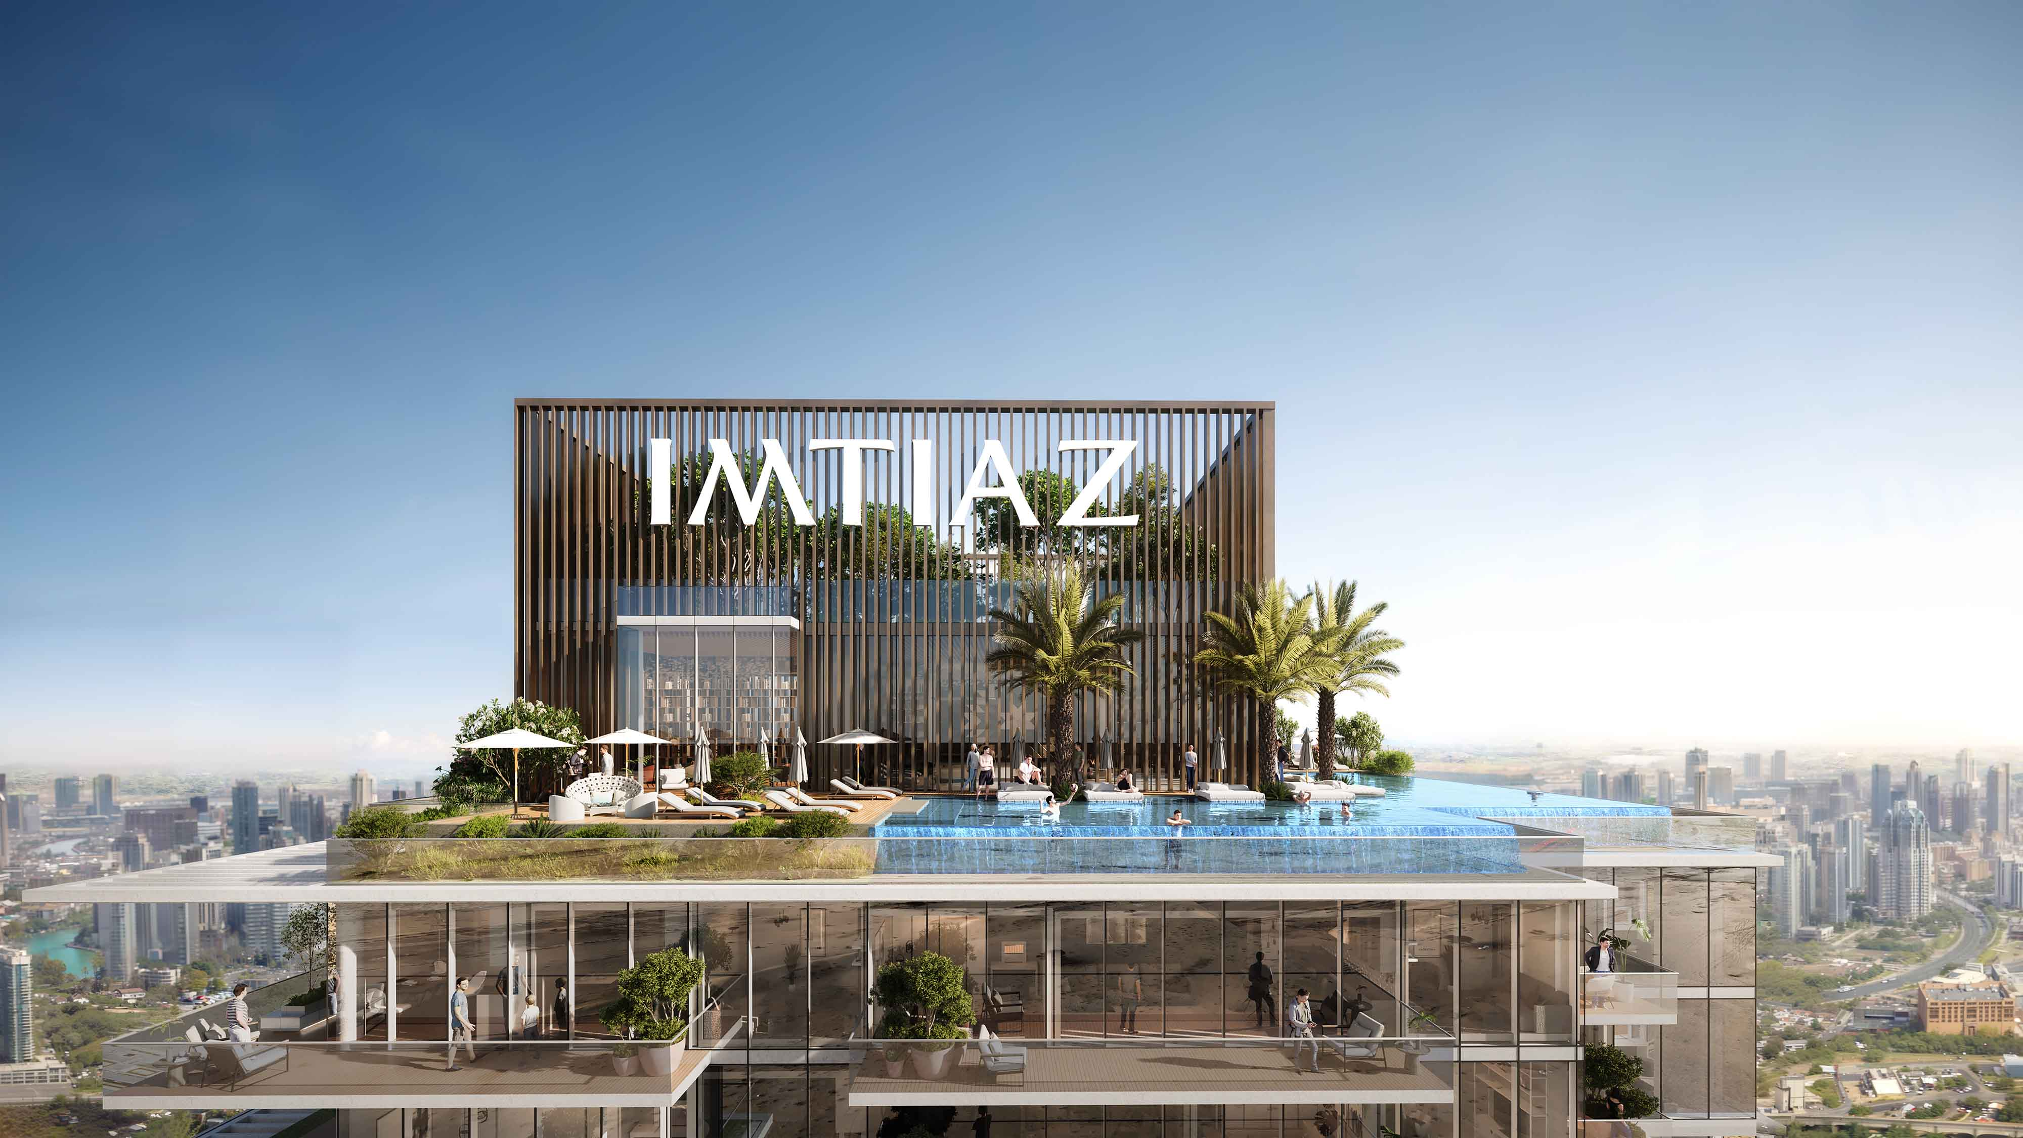

Slide 25
Dubailand
970 K
2028
About the Project
Cove Boulevard by Imtiaz Developments is a modern residential tower in Dubai Residence Complex, Dubailand. With a sleek white façade, curved architecture, and distinctive balconies, it offers a blend of elegance and comfort. The project features fully furnished studios, 1, 2, and 3-bedroom apartments, with select units including private pools on the balcony, providing a unique touch of luxury and stunning city views.
PAYMENT PLAN
40%
during construction
20%
On booking
40%
On Handover

Slide 26
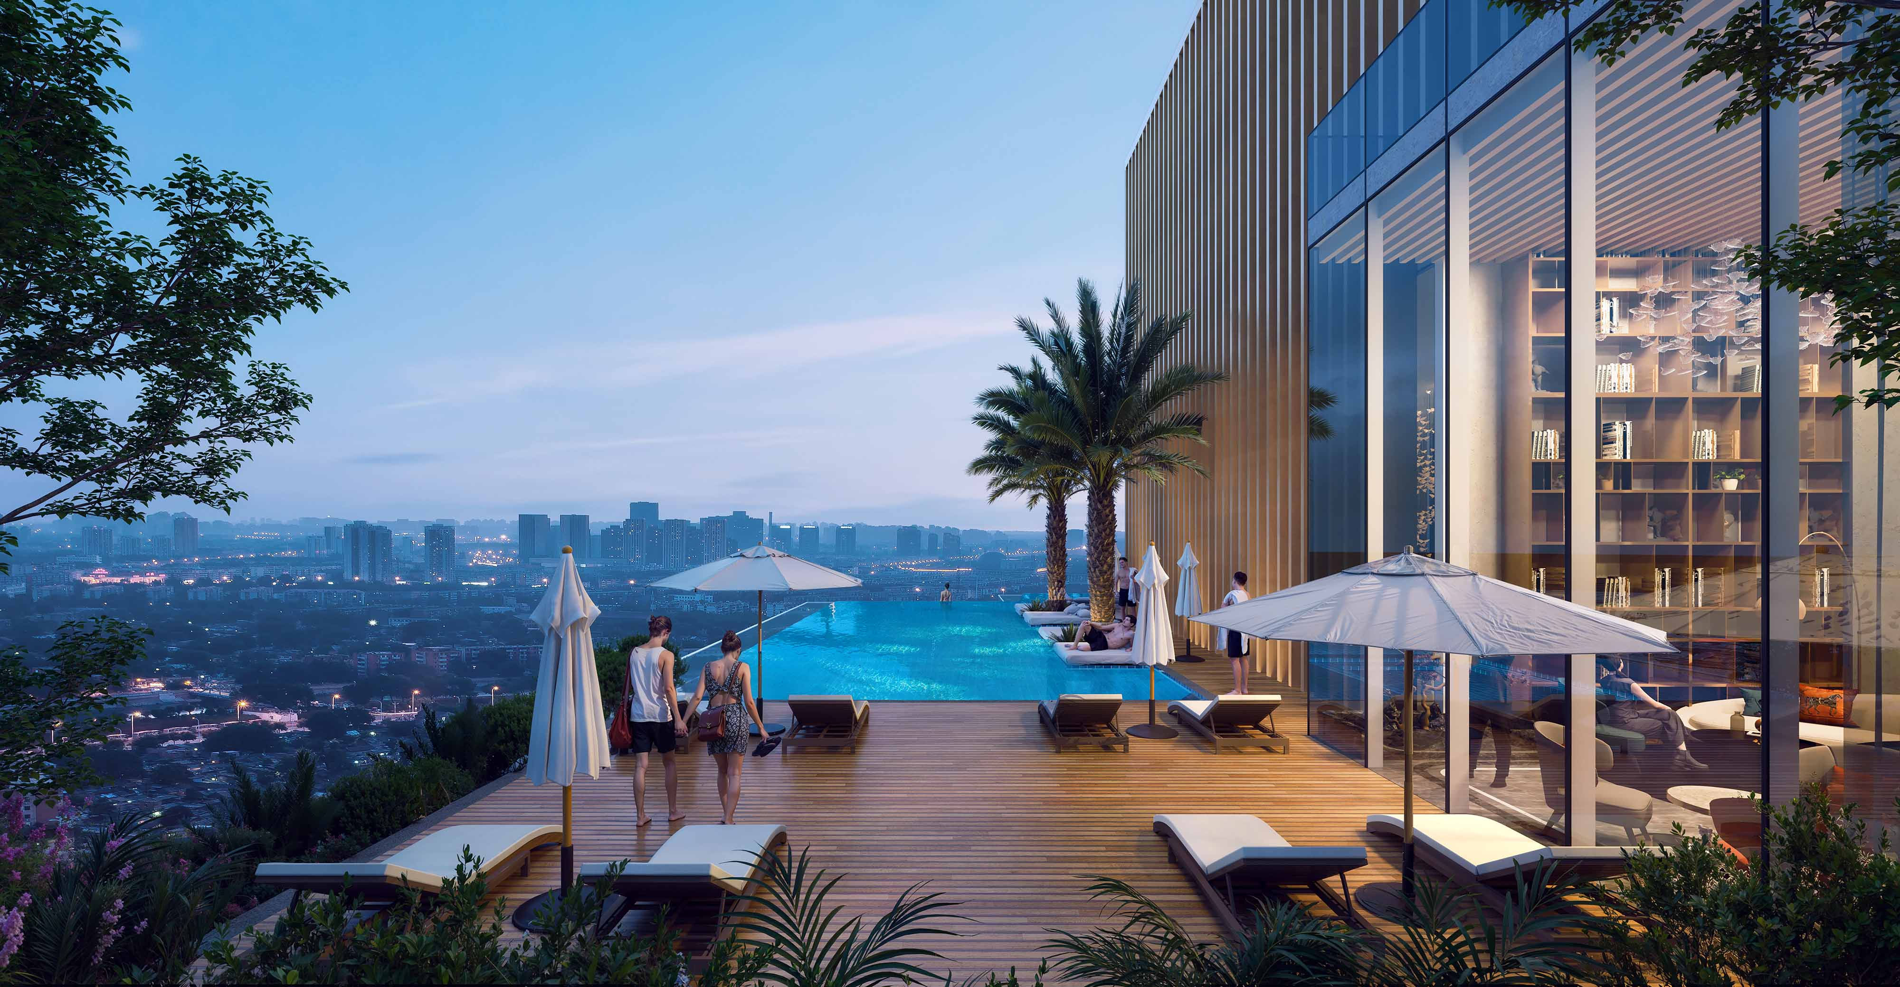
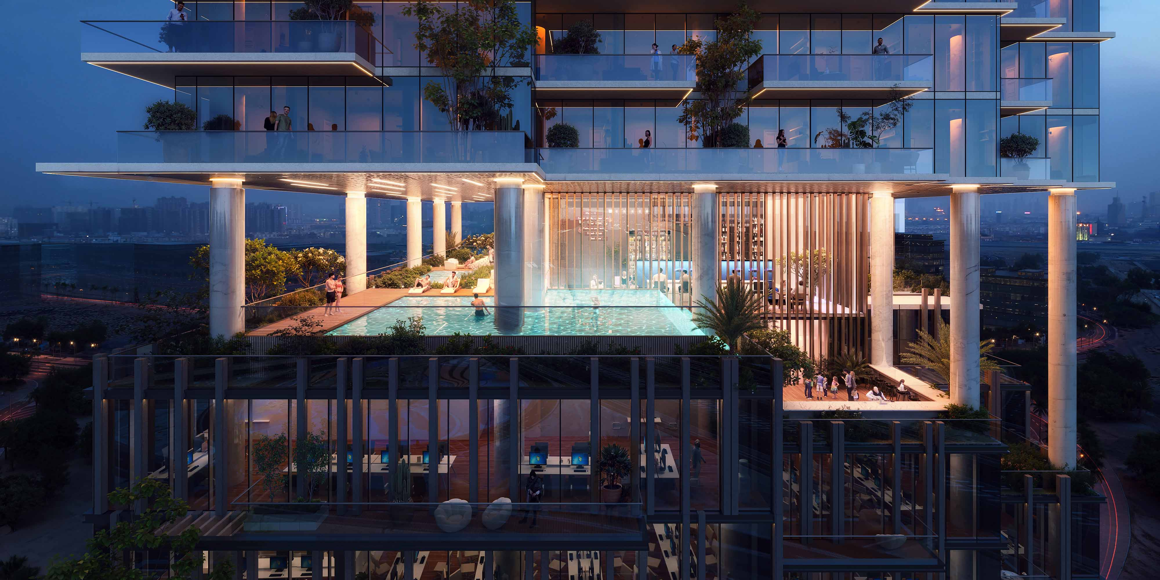
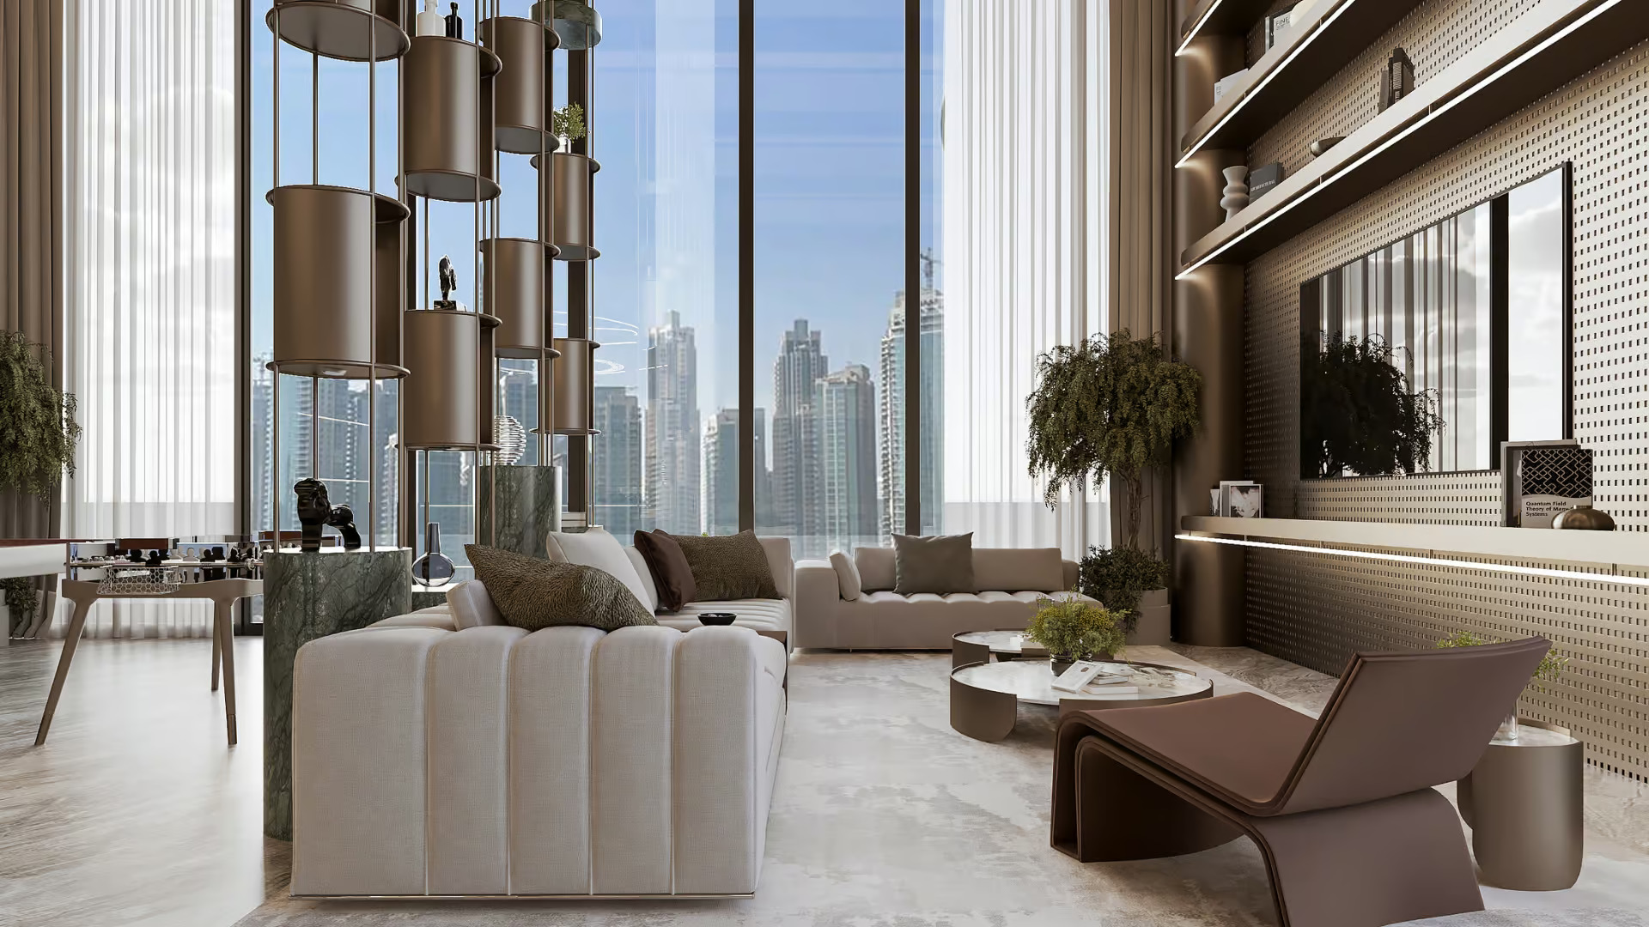
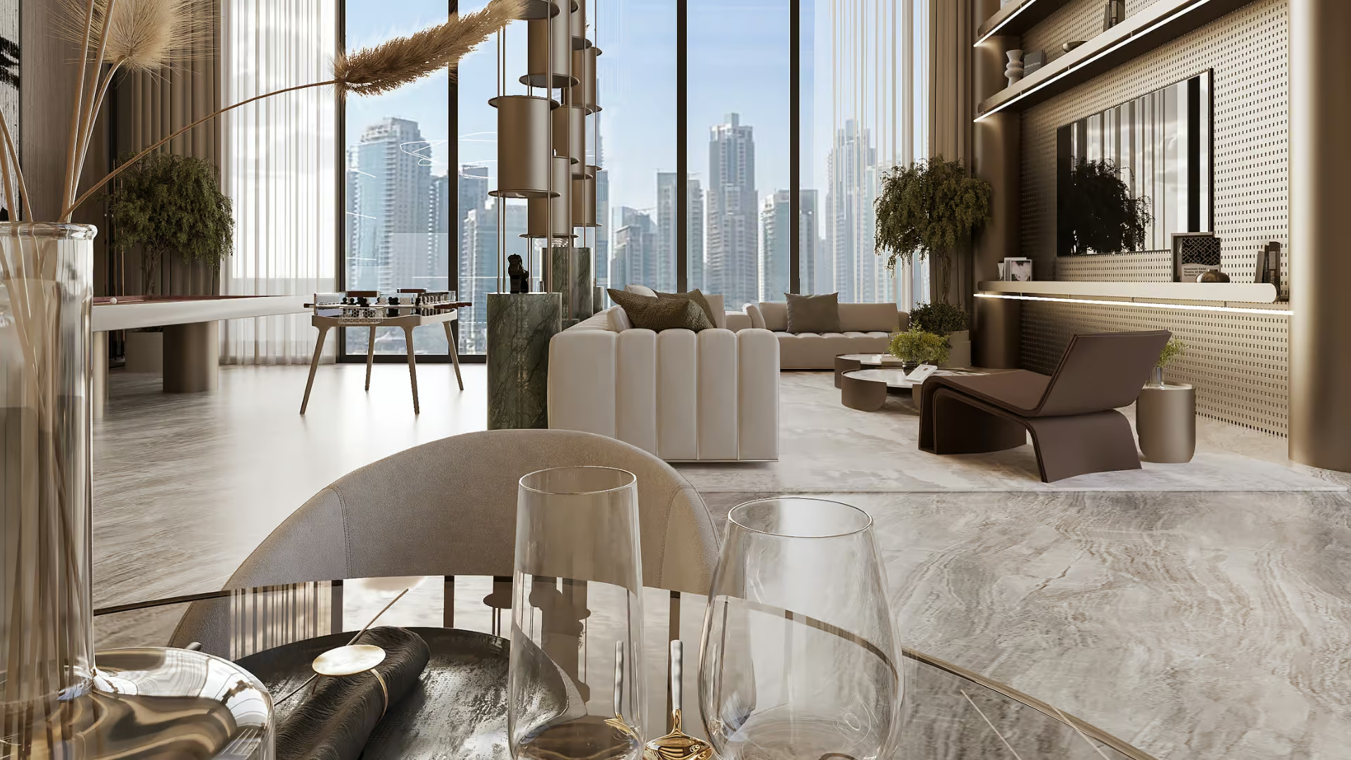
GALLERY

Slide 27
10 Minutes
Dubai Creek Harbour
05 Minutes
Dubai HealthCare
City
07 Minutes
Museum of the future
09 Minutes
DXB Airport

Slide 28
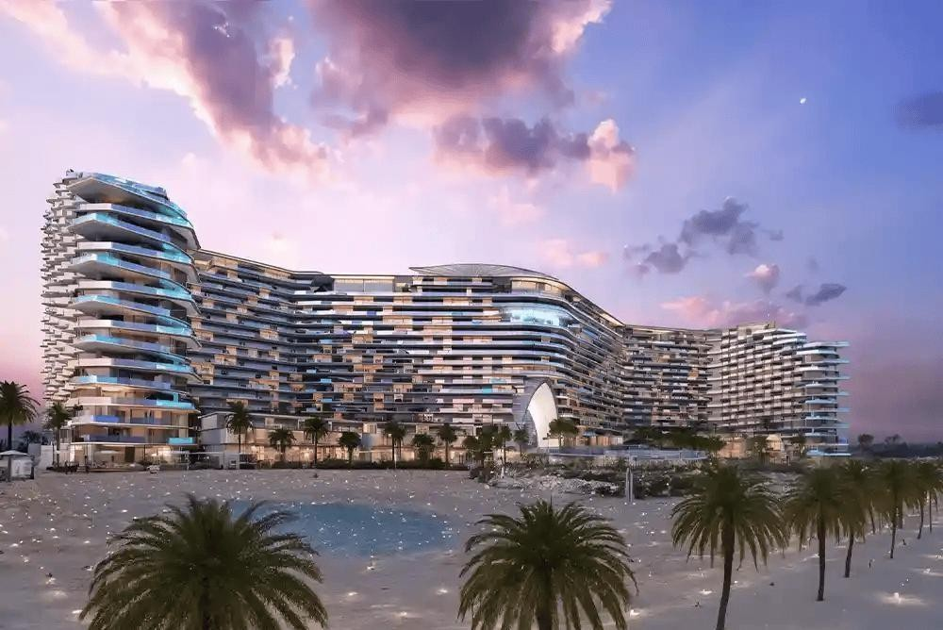

Slide 29
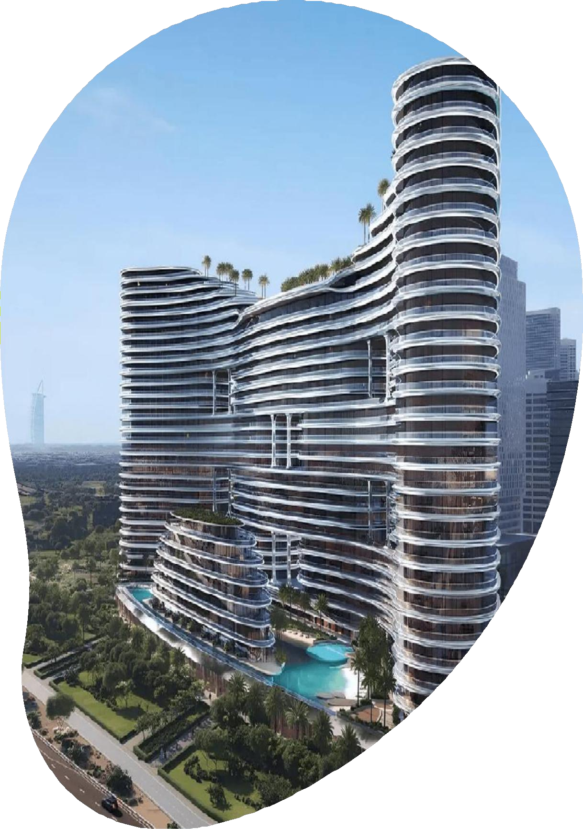
Business Bay
About the Project
2027
AED 999K
Binghatti Aquarise in Business Bay is a 25-storey architectural masterpiece inspired by flowing water, offering studios to 4- bedroom apartments and royal suites.
Located steps from Dubai Canal and minutes from Downtown, it blends urban energy with waterfront tranquility.
With luxury amenities like a sky garden, artificial beach, infinity pool, and wellness zones, it redefines high-end living in Dubai.
PAYMENT PLAN
50%
during construction
30%
On Handover
20%
On booking

Slide 30
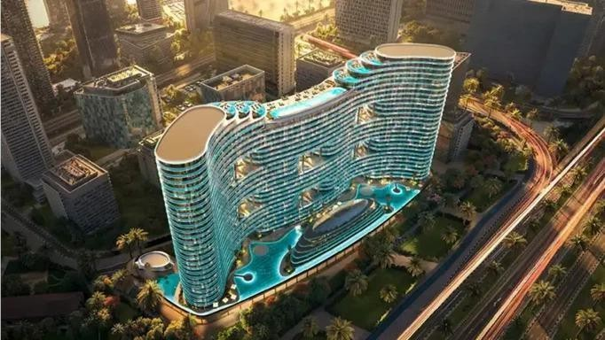
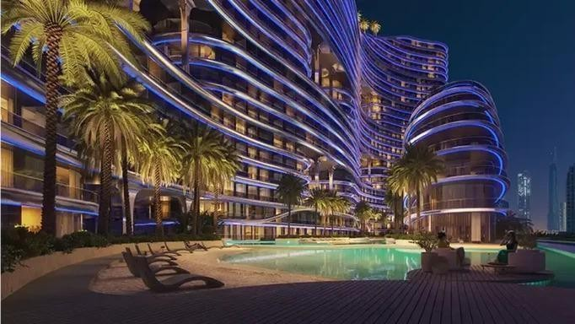
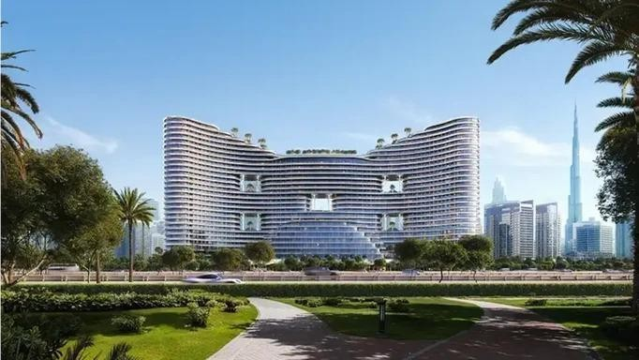
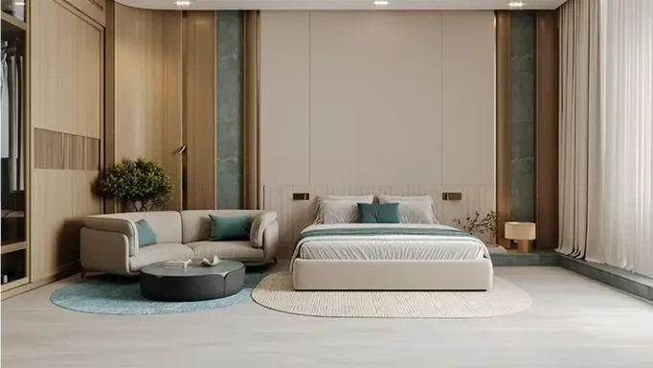
GALLERY

Slide 31
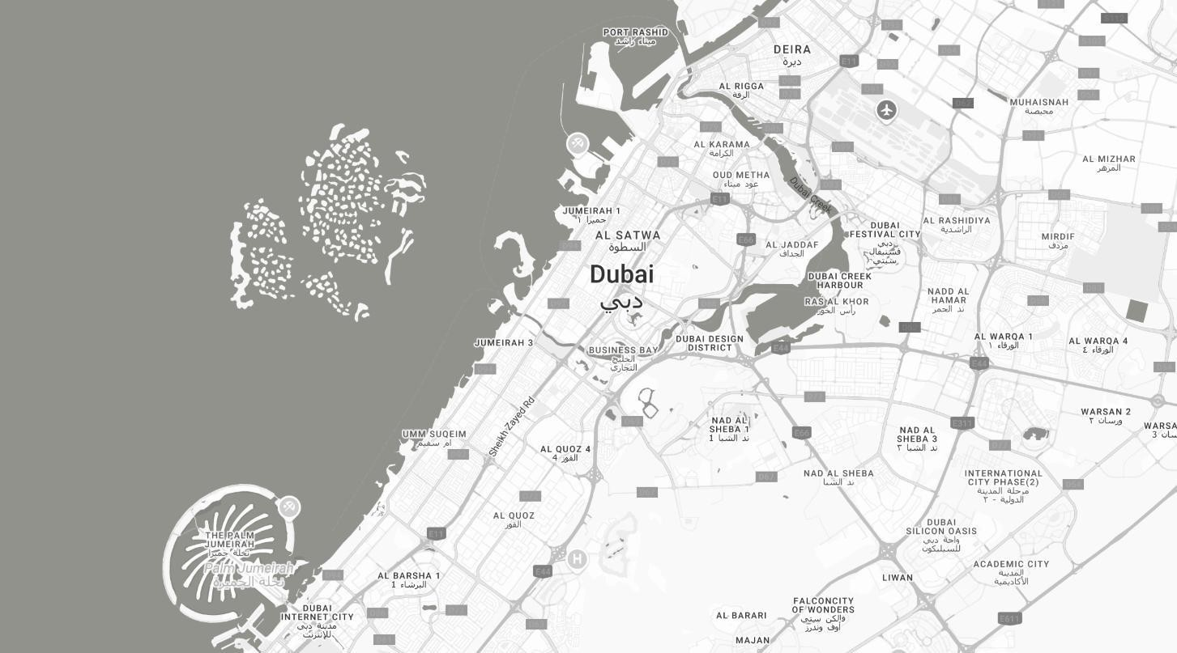
05 Minutes
Dubai Mall
07 Minutes
Burj Khalifa
07 Minutes
Museum of the future
09 Minutes
DXB Airport

Slide 32
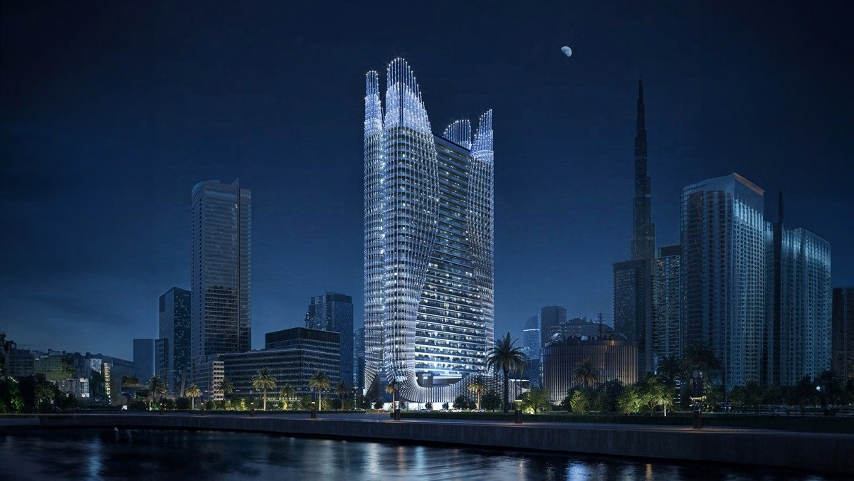

Slide 33
Business Bay
985 K AED
2026
About the Project
Binghatti Skyhall at Business Bay is the forthcoming residential tower, redefines the skyline developed by Binghatti Developers with its breathtaking design apartments in Dubai. This iconic high-rise façade is the latest masterpiece that completes the tale of architectural brilliance in Dubai’s ever vibrant real estate scene. he tower, with is curvaceous façade, reflective glass accents and an illuminated crown is an astounding place to behold during the day and especially at night.
PAYMENT PLAN
50%
during construction
30%
On Handover
20%
On booking

Slide 34
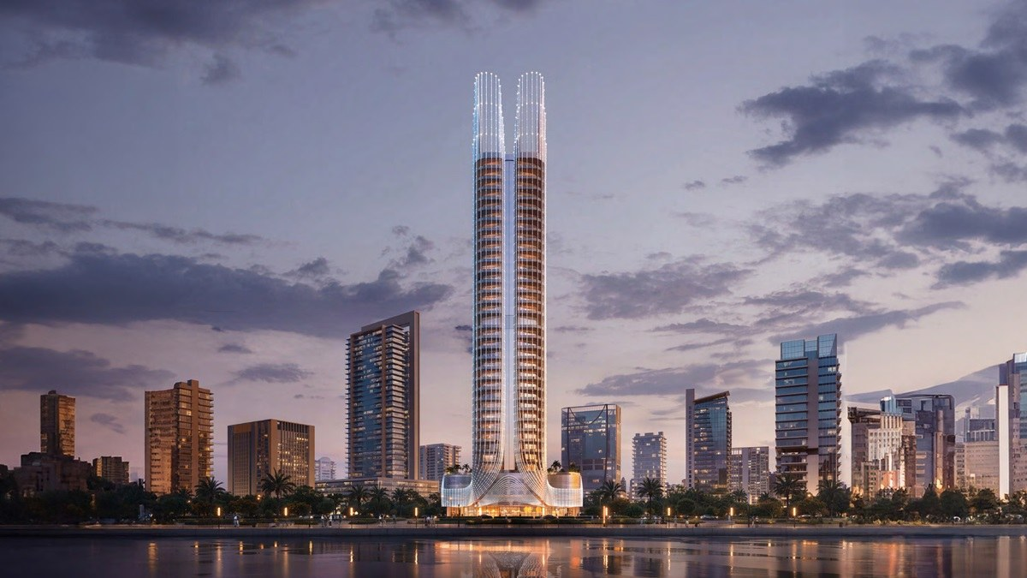
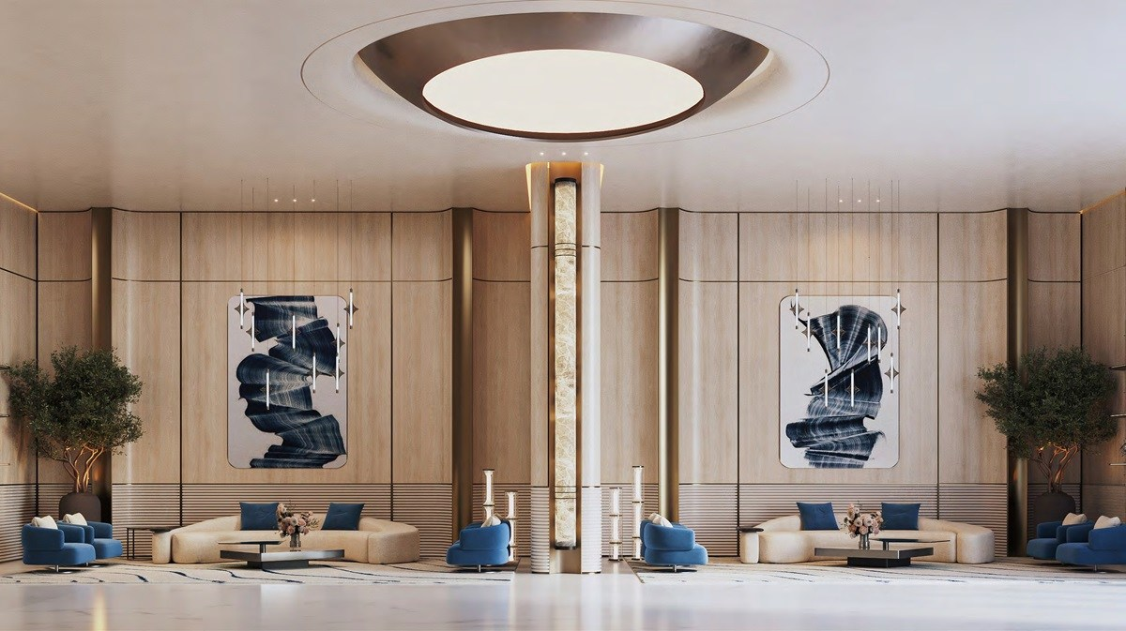
GALLERY

Slide 35
09 Minutes
DIFC
10 Minutes
Downtown Dubai
10 Minutes
Burj Khalifa
25 Minutes
Dubai Marina

Slide 36
Office Address
DAMAC XL Tower 1601,
Business BayDubai, United Arab Emirates
Phone & Mobile
+971 58 598 8464
Email Address
info@laveraproperties.ae
Website
www.laveraproperties.ae

Slide 37
Thank You

